Slide 1


Computational and Experimental Design Single Cell Analysis Program (SCAP) Workshop
September 23-27, 2024
Kilifi, Kenya

Slide 2
Projects
https://www.dropbox.com/scl/fo/e48hj72eoksoxg10nv7en/ANA6OfNaqUsm_udNMzaSBKA?rlkey=f6s6v1b66z4p1nng5rm9984du&st=4exa5o9z&dl=0

Slide 3
Aims
Background
Read papers related to dataset
Explain the methodology used and the experimental design
How many samples? What technology? What was the sample preparation (i.e. dissociation, sorting, enrichment)
What would you change or improve?
Analysis
Perform your own exploratory analysis following notebook we will share
Presentation
Make a short presentation (5-10 slides) reviewing what you learned

Slide 4
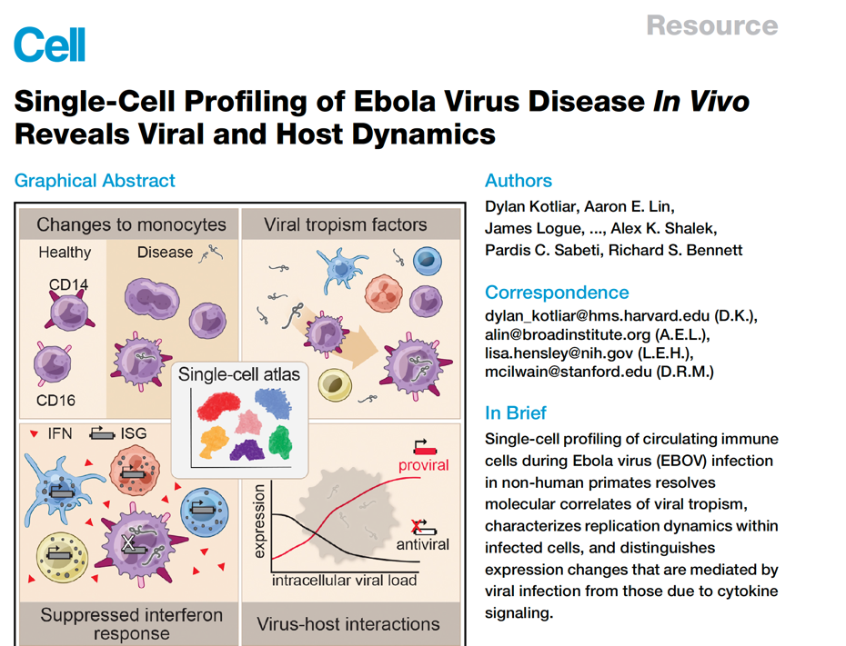
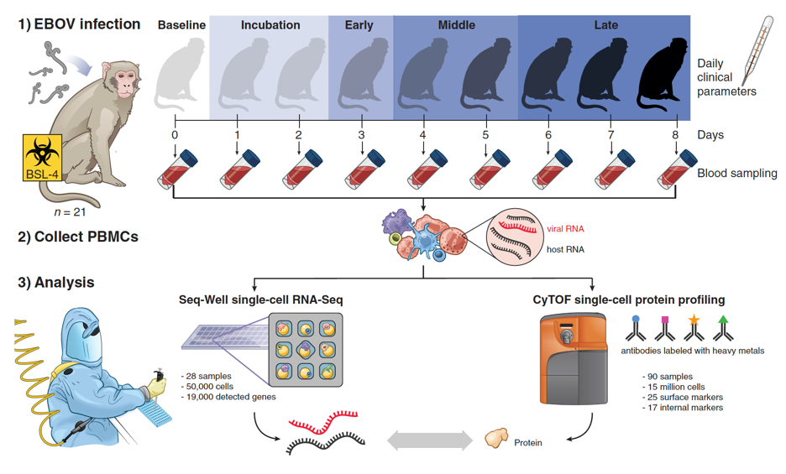
Project 1

Slide 5
Project 1
Single-cell profiling of circulating immune cells during Ebola virus (EBOV) infection in non-human primates resolves molecular correlates of viral tropism, characterizes replication dynamics within infected cells, and distinguishes expression changes that are mediated by viral infection from those due to cytokine signaling.
What do you get:
3607 cells
13 Monkeys
5 Timepoints (DPI)
Questions to Answer.
What is the quality of the cells? Do you need to filter cells?
Is there any batch effect between monkeys?
What are the main cell types present in the sample?
Where can we detect ebola transcripts?
Do you see any differences between timepoints?
Notes:
Single-cell profiling of circulating immunecells during Ebola virus (EBOV) infection in non-human primates resolves molecular correlates of viral tropism, characterizes replication dynamics within infected cells, and distinguishes expression changes that are mediated by viral infection from those due to cytokine signaling.

Slide 6
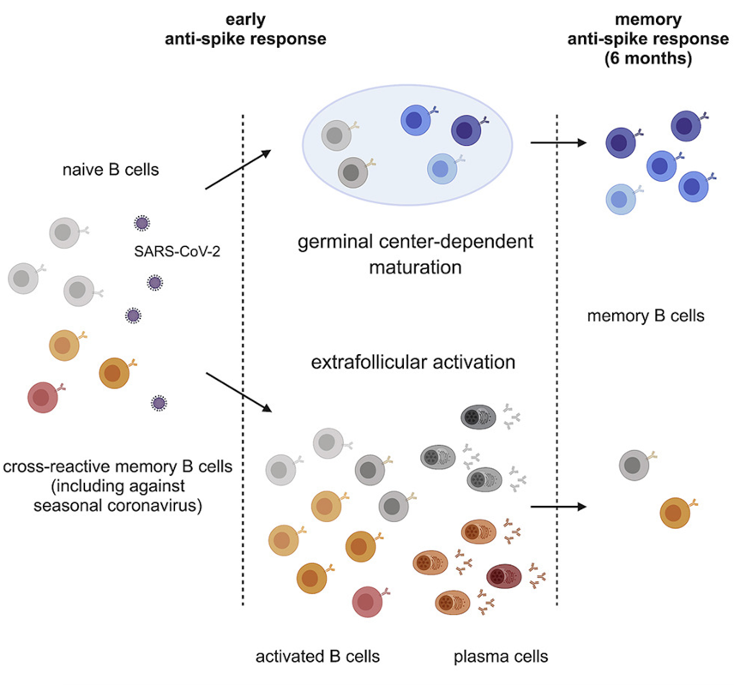
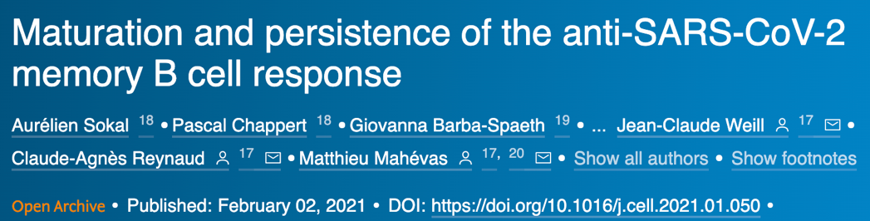
Project 2

Slide 7
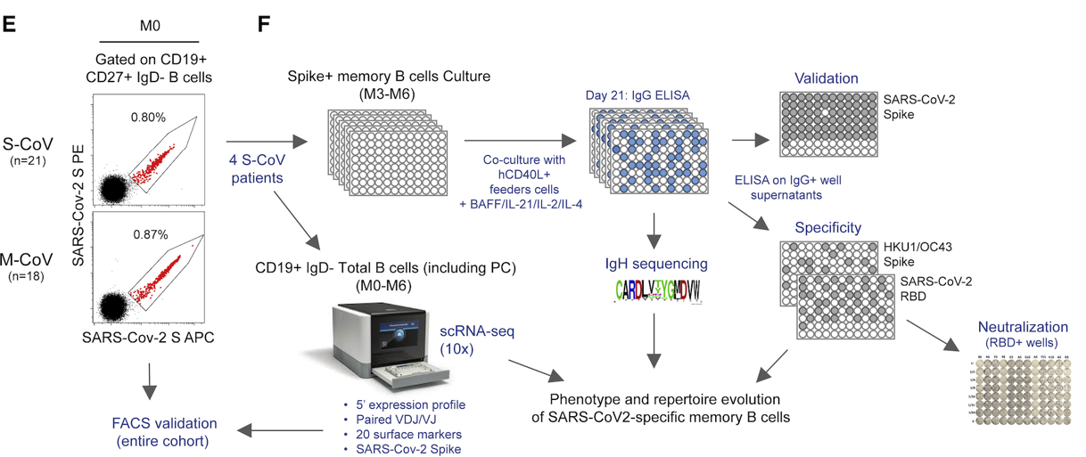
Project 2
Single-cell characterization of B cell transcriptome and B cell receptor usage from patients recovered from SARS-CoV-2 infection. One major question is how pre-existing B cells specific to other coronaviruses contributed to the antibody response to SARS-CoV-2.
“In parallel, to get a broader view of the overall B cell response toward SARS-CoV-2 at both early (M0) and late time points (M6), we sorted CD19⁺IgD⁻ B cells from the same patients and performed single-cell RNA sequencing (scRNA-seq) using the 10X Genomics technology. This allowed us to couple both 5′ scRNA-seq, V(D)J profiling, and feature barcoding of 20 known B cell surface markers, and we also developed anti-His barcoded antibodies to reveal His-tagged SARS-CoV-2 S-specific B cells.”
You get:
Single-cell gene expression and BCR usage from four patients at early and late (6 months) time points after infection
Questions:
What types of B cells are found in patient blood?
Do B cell subsets and BCR sequence clonality change at late vs. early time points?
Do patients with severe vs. moderate disease have distinct types of B cells or BCR usage?

Slide 8

Project 3
Human B cells from a healthy donor pre- and post- flu vaccination (v2)
Human B cells isolated from a healthy female donor pre- and post- influenza vaccination were obtained by 10x Genomics from Discovery Life Sciences.
Post-vaccination sample was obtained 14 days after vaccination.
Gene expression and BCR Amplified libraries were generated from 16,400 cells (85% viable, expected recovery 8,500 cells) as described in the Chromium Next GEM Single Cell 5' Reagent Kits v2 (Dual Index) User Guide (CG000331 Rev A) and sequenced on an Illumina NovaSeq 6000.
Libraries from the pre- and post-vaccination B cells were analyzed using Cell Ranger aggr.
Questions to Answer
- What types of B cells do you observe?
- Are B cell states similar pre- and post-vaccination?
- What are the features of BCRs pre- vs post-vaccination?
- Are there any shared BCR clones across the two time points?
- What are the BCR features and gene expression states of expanded BCR clones?
What do you get:
5000 cells
2 time points
Gene expression and BCR

Slide 9
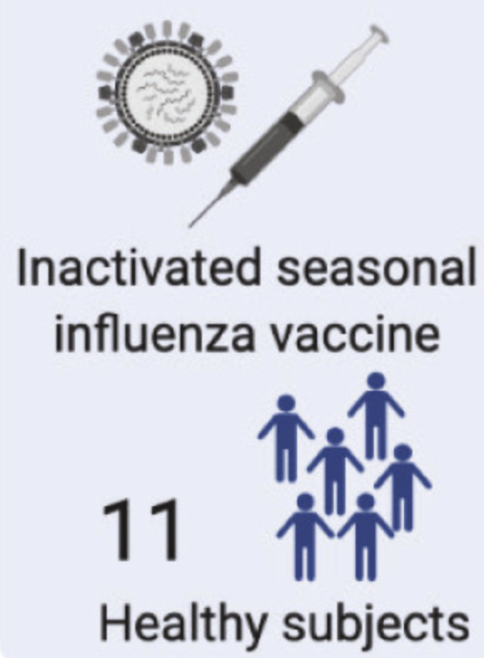
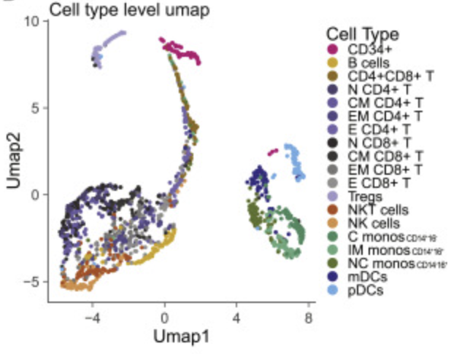
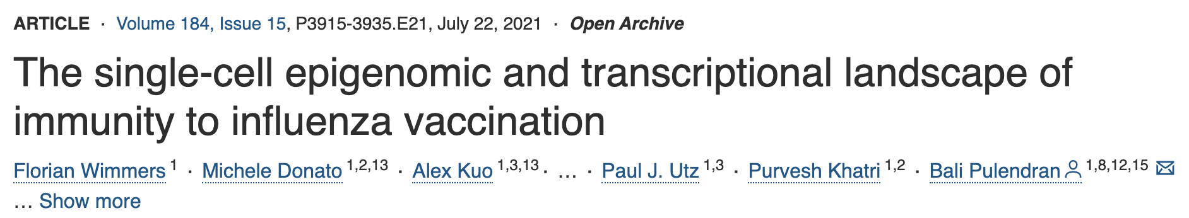
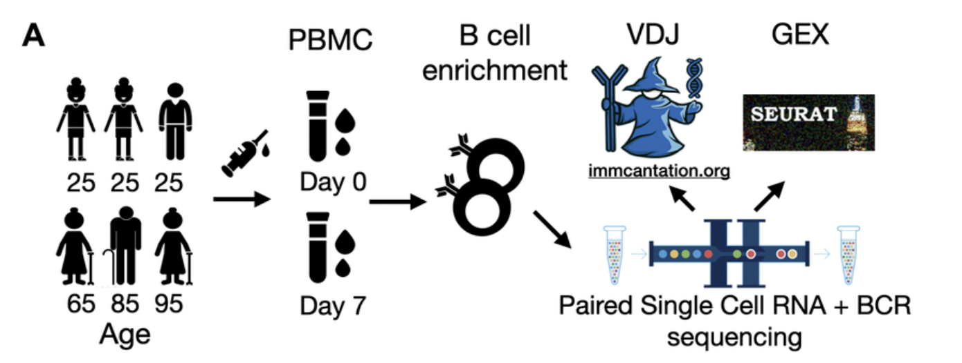

Project 3
Human B cells from a healthy donor pre- and post- flu vaccination (v2)
Related papers

Slide 10
Project 4
PBMC from a Healthy Donor
Non-small cell lung cancer
Melanoma Tumor Derived Cells
Human peripheral blood mononuclear cells (PBMCs) of a healthy male donor aged 27 were obtained by 10x Genomics from AllCells.
A fresh surgical resection of a squamous non-small cell lung carcinoma tumor was obtained by 10x Genomics. Cells were sorted for live cells prior to running. Human Melanoma tumor derived cells of a pre-treatment male donor aged 40 were obtained by 10x Genomics from Discovery Life Sciences.
Questions include:
- What types of cells do you observe in each tissue?
- Are T cell states similar in PBMCs and tumors? Different in each tumor type?
- What are the features of TCRs in PBMC compared to tumors?
- Are there any shared TCR clones across samples?
- What are the TCR features and gene expression states of expanded TCR clones?
What do you get:
5000 cells
3 tissues
Gene expression and TCR

Slide 11

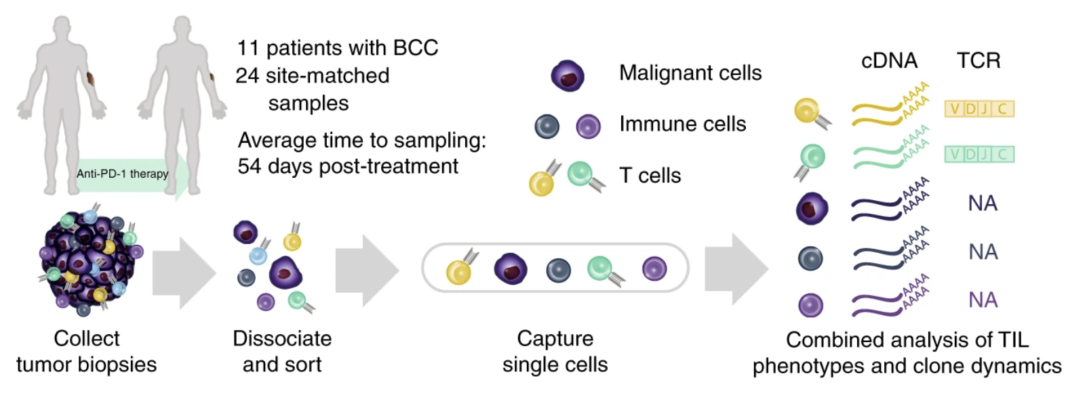

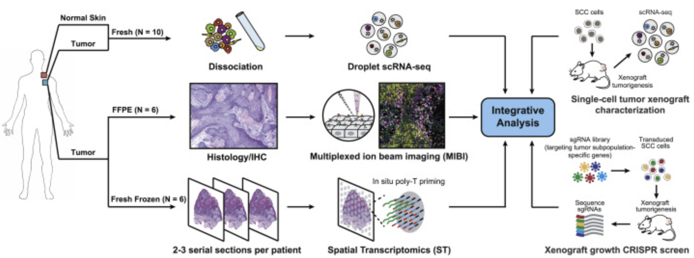
Project 4
PBMC from a Healthy Donor
Non-small cell lung cancer
Melanoma Tumor Derived Cells
Related papers

Slide 12
Old projects from past workshops

Slide 13
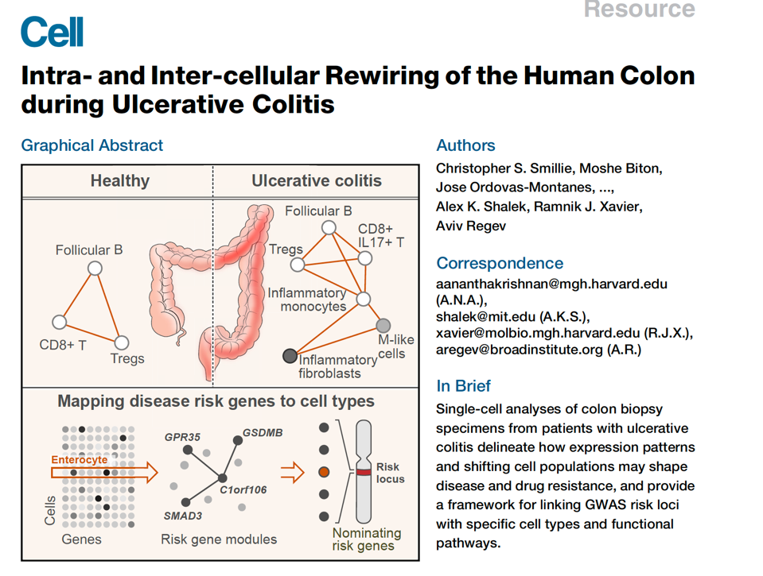
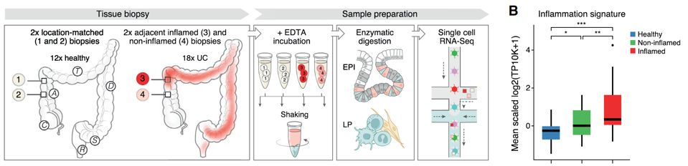
Project 5.

Slide 14

Project 5.
Single-cell analyses of colon biopsy specimens from patients with ulcerative colitis delineate how expression patterns and shifting cell populations may shape disease
What do you get:
4500 cells
30 Donors
3 Types of samples (Healthy and Ulcerative colitis (Non-inflamed and Inflamed))
Questions to Answer.
What is the quality of the cell? Do you need to filter cells?
Is there any batch effect?
What are the main cell types present in the sample?
Do you see any differential expression between the 3 types of samples?

Slide 15
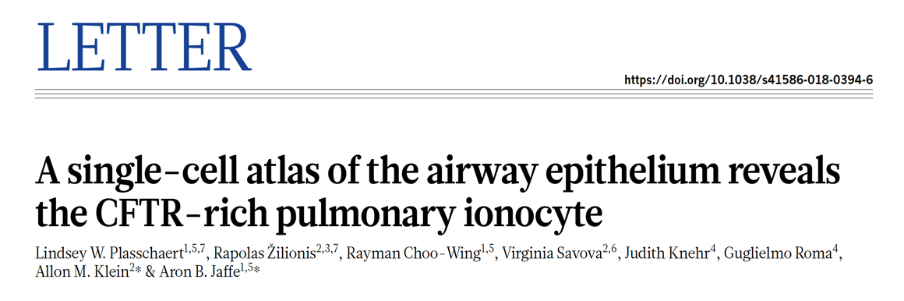
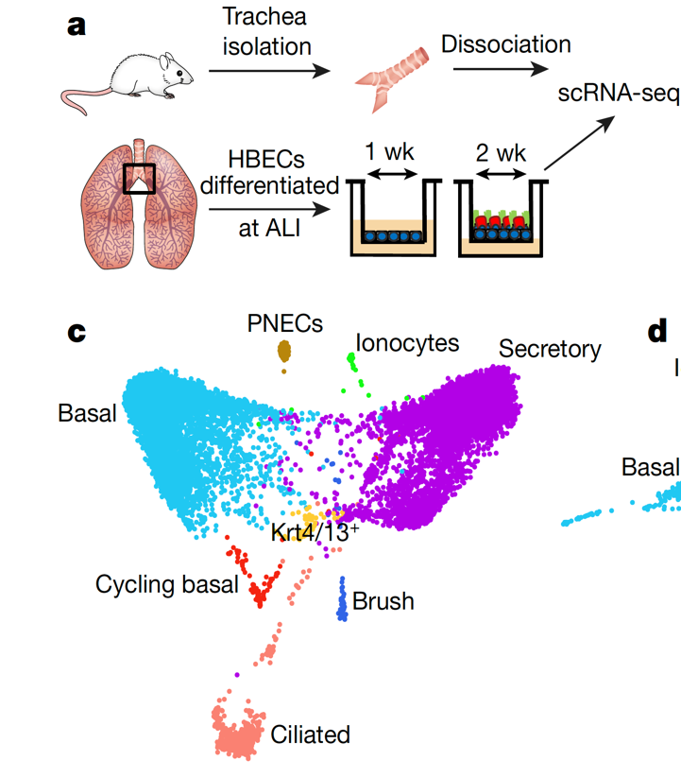
Project 6

Slide 16
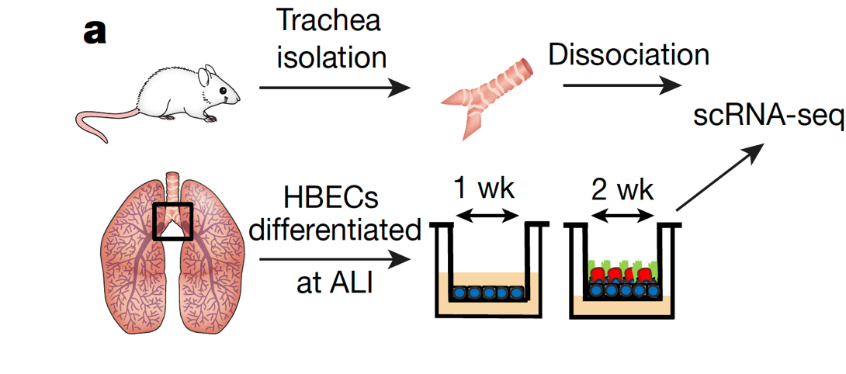
Project 6.
Single-cell analyses reveals cell states that represent known and novel cell populations of the lung, They identified a novel, rare cell type that they call the ‘pulmonary ionocyte’, which co-expresses FOXI1, H+-ATPase (V-ATPase) and CFTR, the gene that is mutated in cystic fibrosis.
What do you get:
From Human
2970 cells
3 Donors
From Mouse
2912 cells
10 Mouse
5 Time points!
Questions to Answer.
What is the quality of the cell? Do you need to filter cells?
Is there any batch effect?
What are the main cell types present in the sample? Can you detect “Pulmonary Ionocyte”? Any changes across time?
Do you see any differences between Mouse and Human data?

Slide 17
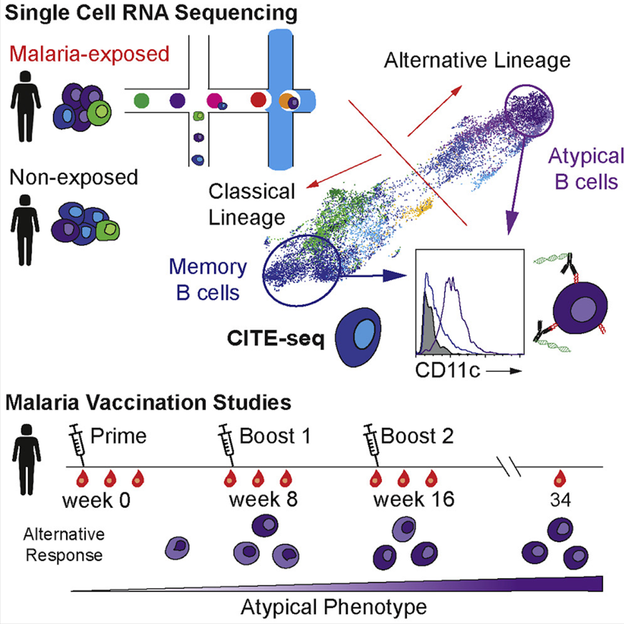


Project 7

Slide 18
Project 7
Single-cell transcriptome and BCR usage data on human donors who have been exposed to malaria or have never been exposed. Authors were interested in the presence and roles of atypical B cells (atBCs) which were previously associated with autoimmune disease.
To further examine the response to natural exposure to malaria, PfCSP-specific B cells, as well as B cells specific for the P. falciparum merozoite surface protein-1 (PfMSP1), were also sorted from 6 adult Kenyans from an area of moderate to high malaria transmission (Figure 1A; Table S1). Individuals in this population carry high numbers of circulating atBCs characterized by the absence of CD21 and CD27 (Aye et al., 2020). Because B cells specific for a given antigen are rare within an individual, only ∼10–50 antigen-specific cells could be sorted per sample. Accordingly, we used a modified version of the relatively low-throughput Smart-seq2 protocol (Picelli et al., 2014) to obtain 163 transcriptomes from 11 individuals.
What you get:
Gene expression and BCR usage for 162 cells from patients exposed or not exposed to malaria.
Questions:
Do B cells expressing BCRs specific to malaria have distinct gene expression profiles?
Do malaria-specific BCRs have distinct receptor gene usage or variable region features?

Slide 19
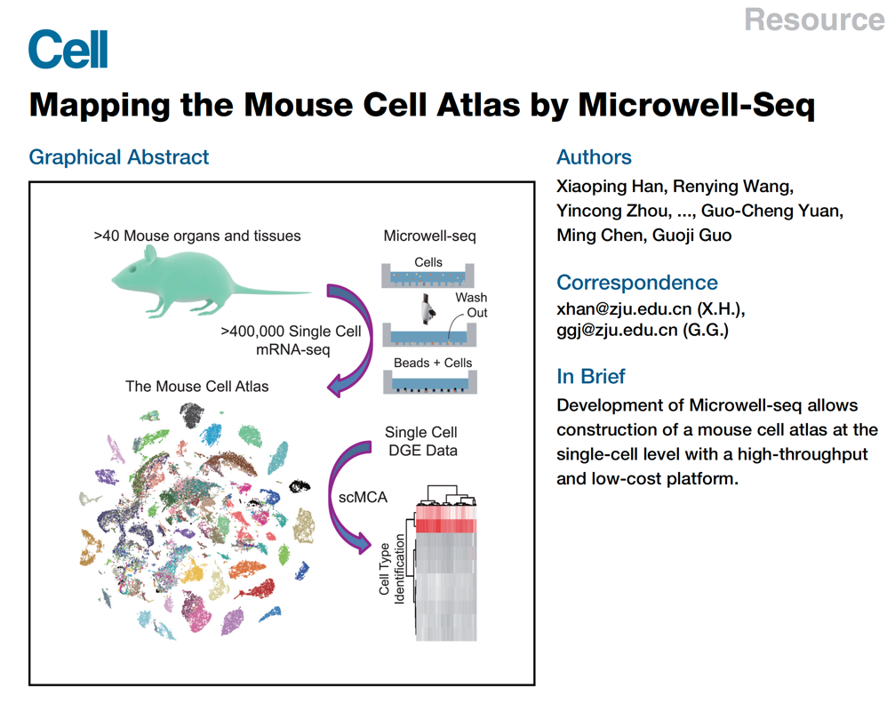
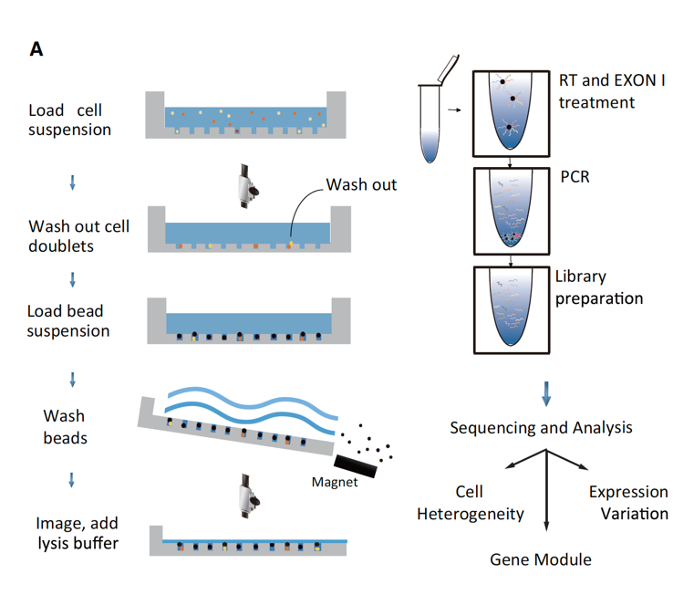
Project 8

Slide 20
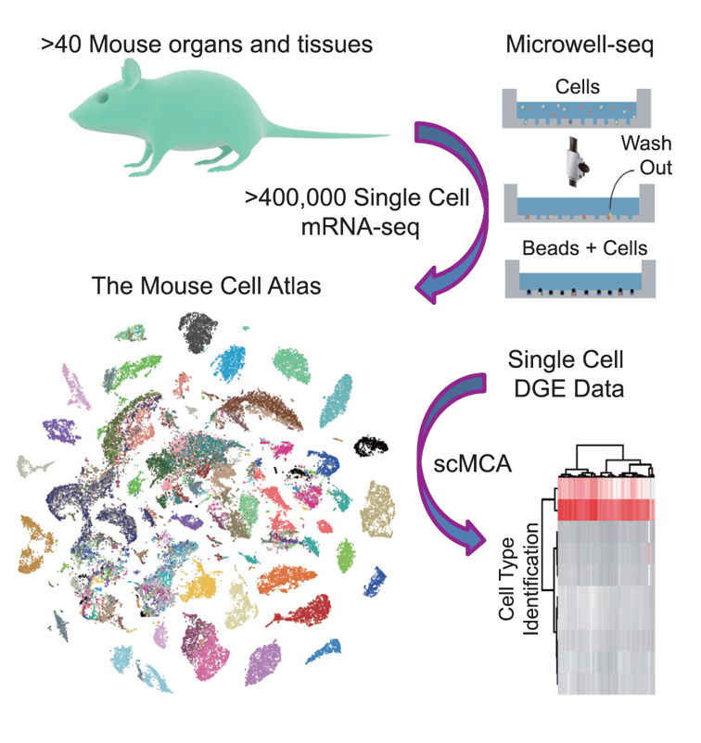
Project 8.
analyzed more than 400,000 single cells covering all of the major mouse organs and constructed a basic scheme for a mouse cell atlas (MCA). We reveal a single-cell hierarchy for many tissues that have not been well characterized previously
What do you get:
4310 cells
6 tissues (5 immune and 1 epithelial)
18 Mouse
Questions to Answer.
What is the quality of the cells? Do you need to filter cells?
Is there any batch effect?
What are the main cell types present in the sample?
Can you detect Immune cells in multiple tissues?
Do you see any differences between the
same immune cell type between tissues?

Slide 21
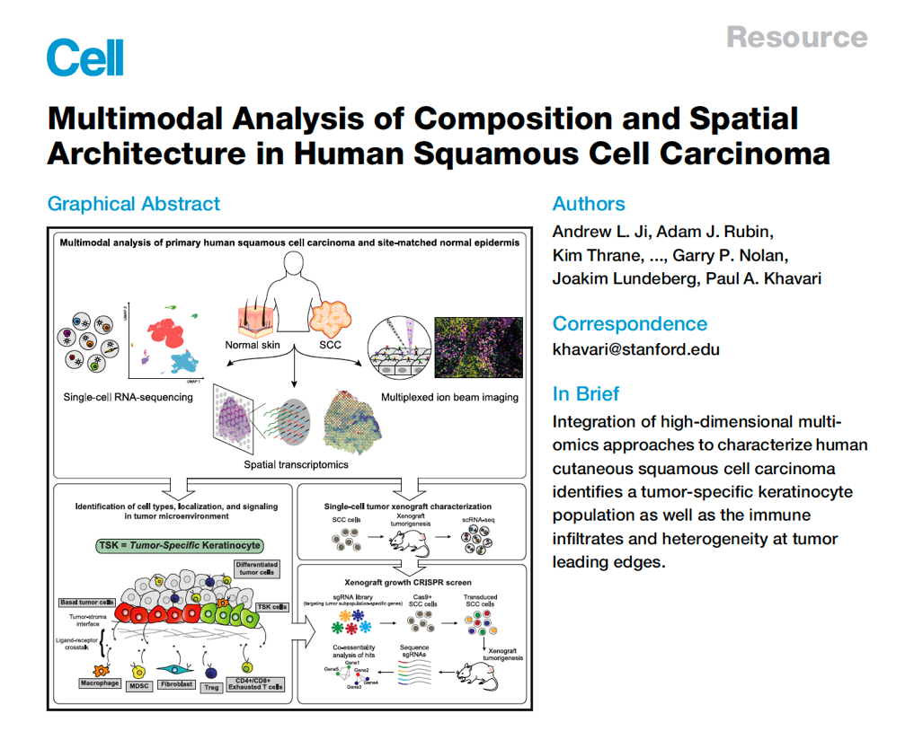
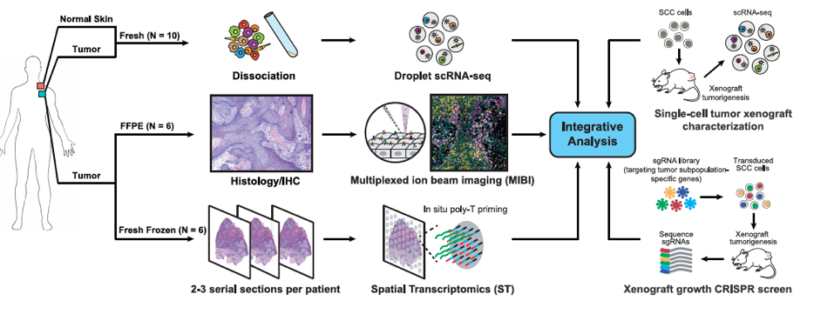
Project 9

Slide 22
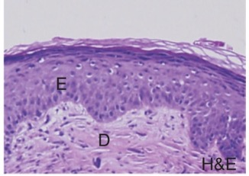
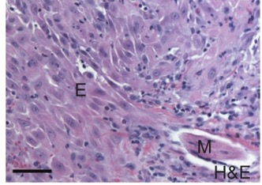
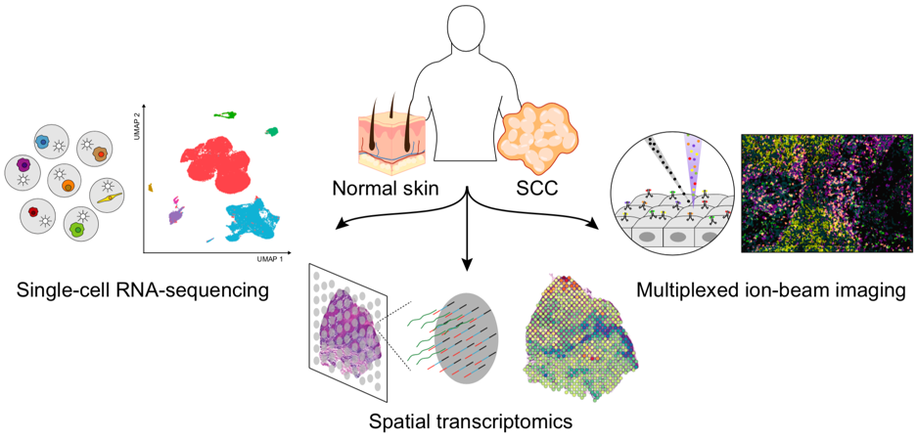
Project 9: comparison of T cells in healthy skin and skim tumors
To define the cellular composition and architecture of cutaneous squamous cell carcinoma (cSCC), we combined single-cell RNA sequencing with spatial transcriptomics and multiplexed ion beam imaging from a series of human cSCCs and matched normal skin. These data define cSCC tumor and stromal cell subpopulations, the spatial niches where they interact, and the communicating gene networks that they engage in cancer.
What do you get
1889 cells
11 donors
Tumor and normal samples
Normal skin
Cutaneous squamous cell carcinoma
Questions
Do T cells in normal tissue look different than T cells in tumors?
Are tumor T cells similar across patients?
What are the types of T cells that we observe in tumors?
Do we see many exhausted or proliferating cells?
Ji et al., 2020

